Slide 1
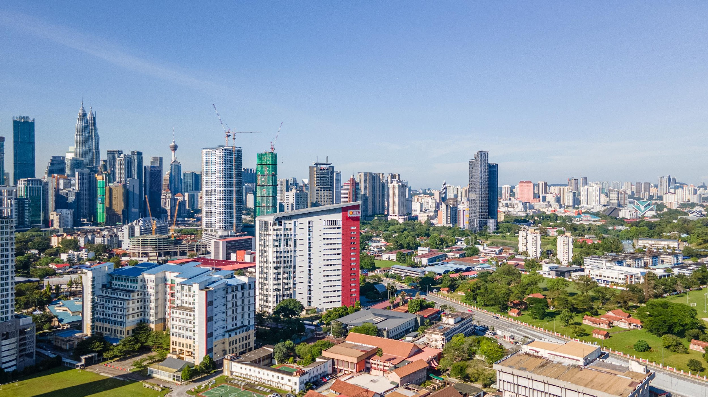

SCST1223
Probability & statistical data analysis
CHAPTER 7
PART 2:
LINEAR REGRESSION MODEL
Innovating Sustainable Solutions

Slide 2
Introduction to Regression Analysis
Regression analysis is used to:
  Predict the value of a dependent variable based on the value of at least one independent variable
  Explain the impact of changes in an independent variable on the dependent variable
Dependent variable: the variable we wish to explain
Independent variable: the variable used to explain the dependent variable

Slide 3
Introduction to Regression Analysis
A regression model that involves a single independent variable is called simple regression.
  Example: imagine that your company wants to understand how past advertising expenditures have related to sales in order to make future decisions about advertising. The dependent variable in this instance is sales and the independent variable is advertising expenditures.

Slide 4
Introduction to Regression Analysis
Usually, more than one independent variable influences the dependent variable.
A regression model that involves two or more independent variables is called multiple regression.
  Example: Sales are influenced by advertising as well as other factors, such as the number of sales representatives and the commission percentage paid to sales representatives

Slide 5
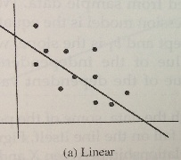
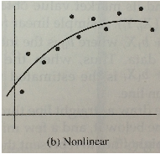
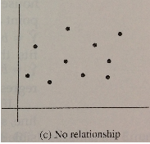
Introduction to Regression Analysis
Regression models can be either linear or nonlinear.
A linear model assumes the relationships between variables are straight-line relationships, while a nonlinear model assumes the relationships between variables are represented by curved lines.

Slide 6
Introduction to Regression Analysis
The most basic type of regression is that of simple linear regression.
A simple linear regression uses only one independent variable, and it describes the relationship between the independent variable and dependent variable as a straight line.
This chapter will focus on the basic case of a simple linear regression.

Slide 7
SCST1223
Probability & statistical data analysis
CHAPTER 7
PART 2:
LINEAR REGRESSION MODEL (1)
Find the Linear Regression Equation
Innovating Sustainable Solutions

Slide 8
Simple Linear Regression Model
Only one independent variable, x.
Relationship between x and y is described by a linear function.
Changes in y are assumed to be caused by changes in x.

Slide 9
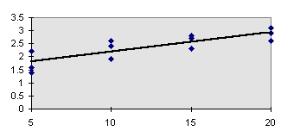
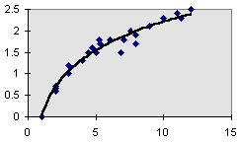
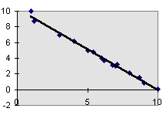
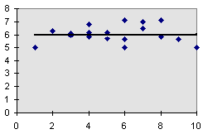
Types of Regression Models
Positive Linear Relationship
Relationship NOT Linear
Negative Linear Relationship
No Relationship

Slide 10
Population Linear Regression
The population regression model:
Population Slope
Coefficient
Random Error term, or residual
Population
y intercept
Independent Variable
Dependent Variable
Linear component
Random Error
component

Slide 11
Linear Regression Assumptions
Error values (ε) are statistically independent
Error values are normally distributed for any given value of x
The probability distribution of the errors is normal
The probability distribution of the errors has constant variance
The underlying relationship between the x variable and the y variable is linear

Slide 12
Population Linear Regression
(continued)
y
Observed Value of y for x_{i}
ε_{i}
Slope = β₁
Predicted Value of y for x_{i}
Random error for this x value (x_{i})
Intercept = β₀
x_{i}
x

Slide 13
Estimated Regression Model
The sample regression line provides an estimate of the population regression line
Estimated (or predicted) y value
Estimate of the regression
intercept
Estimate of the regression slope
Independent variable
The individual random error terms e_{i} have a mean of zero.

Slide 14
Least Squares Criterion
b₀ and b₁ are obtained by finding the values of b₀ and b₁ that minimize the sum of the squared residuals

Slide 15
The Least Squares Equation
The formulas for b₁ and b₀ are:
algebraic equivalent:
and

Slide 16
Interpretation of the
Slope and the Intercept
b₀ is the estimated average value of y when the value of x is zero
b₁ is the estimated change in the average value of y as a result of a one-unit change in x

Slide 17
Finding the Least Squares Equation
The coefficients b₀ and b₁ will usually be found using computer software, such as R, Excel or SPSS
Other regression measures will also be computed as part of computer-based regression analysis

Slide 18

Example
A real estate agent wishes to examine the relationship between the selling price of a home and its size (measured in square feet)
A random sample of 10 houses is selected
  Dependent variable (y) = house price in $1000s
  Independent variable (x) = square feet

Slide 19
Example
House Price in $1000s (y) | Square Feet (x)
245 | 1400
312 | 1600
279 | 1700
308 | 1875
199 | 1100
219 | 1550
405 | 2350
324 | 2450
319 | 1425
255 | 1700

Slide 20
Example
y | x | xy | x²
245 | 1400 | 343000 | 1960000
312 | 1600 | 499200 | 2560000
279 | 1700 | 474300 | 2890000
308 | 1875 | 577500 | 3515625
199 | 1100 | 218900 | 1210000
219 | 1550 | 339450 | 2402500
405 | 2350 | 951750 | 5522500
324 | 2450 | 793800 | 6002500
319 | 1425 | 454575 | 2030625
255 | 1700 | 433500 | 2890000
Σy=2865 | Σx= 17150 | Σxy= 5085975 | Σx²=30983750

Slide 21
Example

Slide 22

Graphical Presentation
House price model: scatter plot and regression line
Slope
= 0.110
Intercept
= 98.248

Slide 23
Interpretation of the Intersection Coefficient, b₀
Interpretation of the Intercept, b₀
b₀ is the estimated average value of Y when the value of X is zero (if x = 0 is in the range of observed x values)
  Here, no houses had 0 square feet, so b₀ = 98.248 just indicates that, for houses within the range of sizes observed, $98,248.33 is the portion of the house price not explained by square feet

Slide 24
Interpretation of the Slope Coefficient, b₁
b₁ measures the estimated change in the average value of Y as a result of a one-unit change in X
  Here, b₁ = 0.110 tells us that the average value of a house increases by 0.110 ($1000) = $110, on average, for each additional one square foot of size

Slide 25
Least Squares Regression Properties
The sum of the residuals from the least squares regression line is 0 ( )
The sum of the squared residuals is a minimum (minimized )
The simple regression line always passes through the mean of the y variable and the mean of the x variable
The least squares coefficients are unbiased estimates of β₀ and β₁

Slide 26
Exercise #1
Representative data on x = carbonation depth (in millimeters) and y = strength (in mega pascals) for a sample of concrete core specimens taken from a particular building were read from a plot in the article “The Carbonation of Concrete Structures in the Tropical Environment of Singapore” (Magazine of Concrete Research [1996]: 293-300);
Depth, x | 8 | 20 | 20 | 30 | 35 | 40 | 50 | 55 | 65
Strength, y | 22.8 | 17.1 | 21.1 | 16.1 | 13.4 | 12.4 | 11.4 | 9.7 | 6.8

Slide 27
Exercise #1
Construct a scatterplot. Does the relationship between carbonation depth and strength appear to be linear?
Find the equation of the least-square line.
What would you predict for strength when carbonation depth is 25 mm?
Explain why it would not be reasonable to use the least-square line to predict strength when carbonation depth is 100 mm.

Slide 28
SCST1223
Probability & statistical data analysis
CHAPTER 7
PART 2:
LINEAR REGRESSION MODEL (2)
Find the Coefficient of Determination (R)
Innovating Sustainable Solutions

Slide 29
Coefficient of Determination R²
The coefficient of determination (denoted by R²) is a key output of regression analysis.
It is interpreted as the proportion of the variance in the dependent variable that is predictable from the independent variable.

Slide 30
Explained and Unexplained Variation
Total variation is made up of two parts:
Total sum of Squares
Sum of Squares Error
Sum of Squares Regression
where:
= Average value of the dependent variable
y = Observed values of the dependent variable
= Estimated value of y for the given x value

Slide 31
Explained and Unexplained Variation
(continued)
SST = total sum of squares
  Measures the variation of the y_{i} values around their mean y
SSE = error sum of squares
  Variation attributable to factors other than the relationship between x and y
SSR = regression sum of squares
  Explained variation attributable to the relationship between x and y

Slide 32
Explained and Unexplained Variation
(continued)
y
y
x
X_{i}

Slide 33
Coefficient of Determination, R²
The coefficient of determination is the portion of the total variation in the dependent variable that is explained by variation in the independent variable
The coefficient of determination is also called R-squared and is denoted as R²
where

Slide 34
Coefficient of Determination, R²
Coefficient of determination
Note: In the single independent variable case, the coefficient of determination is
where:
R² = Coefficient of determination
r = Simple correlation coefficient

Slide 35
Examples of Approximate
R² Values
y
R² = 1
Perfect linear relationship between x and y:
100% of the variation in y is explained by variation in x
x
R² = 1
y
x
R² = +1

Slide 36
Examples of Approximate
R² Values
y
0 < R² < 1
Weaker linear relationship between x and y:
Some but not all of the variation in y is explained by variation in x
x
y
x

Slide 37
Examples of Approximate
R² Values
R² = 0
y
No linear relationship between x and y:
The value of y does not depend on x. (None of the variation in y is explained by variation in x)
x
R² = 0

Slide 38

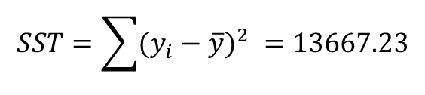
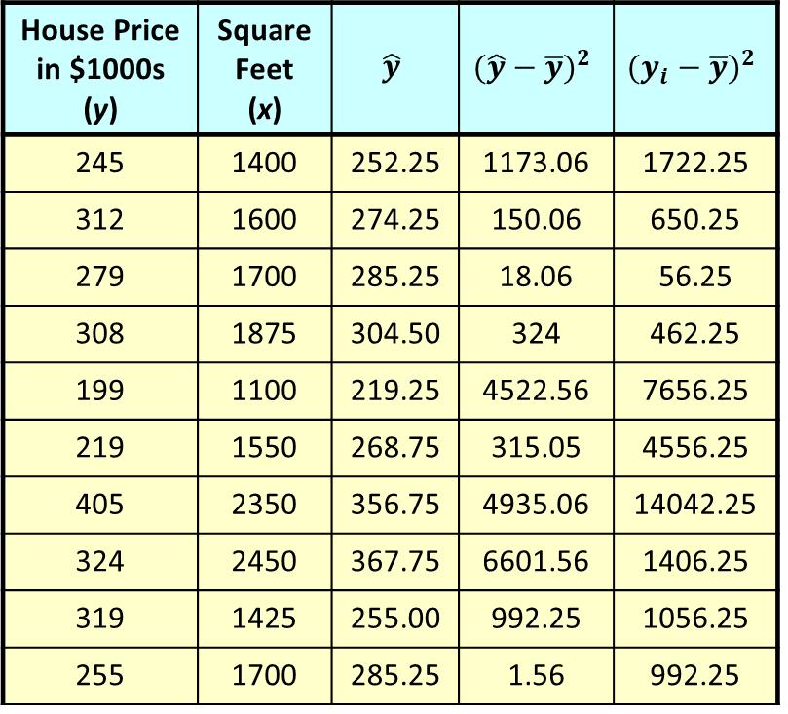
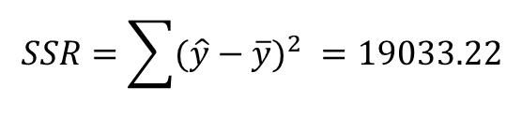
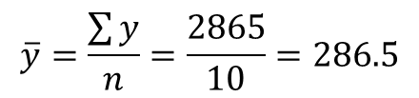
Example
House Price in $1000s (y) | Square Feet (x) | $$\hat{y}$$ | $${(\hat{y}−\overline{y})}^{2}$$ | $${(y_{i}−\overline{y})}^{2}$$
245 | 1400 | 252.25 | 1173.06 | 1722.25
312 | 1600 | 274.25 | 150.06 | 650.25
279 | 1700 | 285.25 | 18.06 | 56.25
308 | 1875 | 304.50 | 324 | 462.25
199 | 1100 | 219.25 | 4522.56 | 7656.25
219 | 1550 | 268.75 | 315.05 | 4556.25
405 | 2350 | 356.75 | 4935.06 | 14042.25
324 | 2450 | 367.75 | 6601.56 | 1406.25
319 | 1425 | 255.00 | 992.25 | 1056.25
255 | 1700 | 285.25 | 1.56 | 992.25
$$\overline{y}=\frac{\sum{y}}{n}=\frac{2865}{10}=286.5$$
$$SSR=\sum{{(\hat{y}−\overline{y})}^{2} =19033.22}$$
$$SST=\sum{{(y_{i}−\overline{y})}^{2} =13667.23}$$
$R^{2}=\frac{SSR}{SST}=\frac{19033.22}{31700.5}=$0.60
60% of the variation in house prices is explained by variation in square feet

Slide 39
Standard Error of Estimate
The standard deviation of the variation of observations around the regression line is estimated by
Where
SSE = Sum of squares error
n = Sample size
k = number of independent variables in the model

Slide 40
Exercise #2
The following data on sale, size, and land-to-building ratio for 10 large industrial properties appeared in the paper “Using Multiple Regression Analysis in Real Estate Appraisal” (Appraisal Journal [2002]: 424-430):

Slide 41
Exercise #2
Property | Sale Price (millions of dollars) | Size (thousands of sq. ft.) | Land-to-Building Ratio
1 2 3 4 5 6 7 8 9 10 | 10.6 2.6 30.5 1.8 20.0 8.0 10.0 6.7 5.8 4.5 | 2166 751 2422 224 3917 2866 1698 1046 1108 405 | 2.0 3.5 3.6 4.7 1.7 2.3 3.1 4.8 7.6 17.2

Slide 42
Exercise #2
Calculate and interpret the value of the correlation coefficient between sale price and size.
Calculate and interpret the value of the correlation co-efficient between sale price and land-to-building ratio.
If you wanted to predict sale price and you could use either size or land-to-building ratio as the basis for making predictions, which would you use? Explain.
Based on your choice in Part (c), find the equation of the least-square regression line you would use for predicting y = sale price.

Slide 43
SCST1223
Probability & statistical data analysis
CHAPTER 7
PART 2:
LINEAR REGRESSION MODEL (3)
Test the Inference using T test
Innovating Sustainable Solutions

Slide 44
The Standard Deviation of the Regression Slope
The standard error of the regression slope coefficient (b₁) is estimated by
where:
= Estimate of the standard error of the least squares slope
= Sample standard error of the estimate

Slide 45
Comparing Standard Errors
Variation of observed y values from the regression line
Variation in the slope of regression lines from different possible samples
y
y
x
x
y
y
x
x

Slide 46
Inference about the Slope: t Test
t-test for a population slope
  Is there a linear relationship between x and y?
Null and alternative hypotheses
  H₀: β₁ = 0 (no linear relationship)
  H₁: β₁ ≠ 0 (linear relationship does exist)
Test statistic
where:
b₁ = Sample regression slope
coefficient
β₁ = Hypothesized slope
s_{b1} = Estimator of the standard
error of the slope

Slide 47
Inference about the Slope: t Test
House Price in $1000s (y) | Square Feet (x)
245 | 1400
312 | 1600
279 | 1700
308 | 1875
199 | 1100
219 | 1550
405 | 2350
324 | 2450
319 | 1425
255 | 1700
(continued)
Estimated Regression Equation:
The slope of this model is 0.110
Does square footage of the house affect its sales price?

Slide 48
Inferences about the Slope: t Test Example
H₀: β₁ = 0
H_{A}: β₁ ≠ 0
House Price in $1000s (y) | Square Feet (x)
245 | 1400 | 252.25 | 52.56
312 | 1600 | 274.25 | 1425.06
279 | 1700 | 285.25 | 39.06
308 | 1875 | 304.50 | 12.25
199 | 1100 | 219.25 | 410.06
219 | 1550 | 268.75 | 2475.06
405 | 2350 | 356.75 | 2328.06
324 | 2450 | 367.75 | 1914.06
319 | 1425 | 255.00 | 4096
255 | 1700 | 285.25 | 915.06
b₁

Slide 49
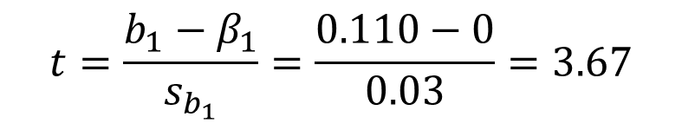
Inferences about the Slope: t Test Example
$$t=\frac{b_{1}−β_{1}}{s_{b_{1}}}=\frac{0.110−0}{0.03}=3.67$$
α/2=.025
α/2=.025
Test Statistic: t = 3.67
Reject H₀
Do not reject H₀
Reject H₀
-t_{α/2}
t_{α/2}
0
d.f. = 10-2 = 8
a =.05
a/2=.025
t_{α/2} = 2.3060 (refer to table)
-2.3060
2.3060
3.67
Decision:
Conclusion:
Reject H₀
There is sufficient evidence that square footage affects house price

Slide 50
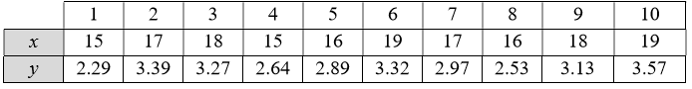
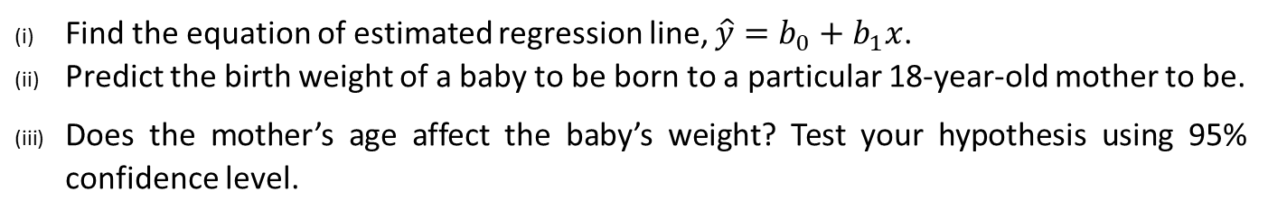
Exercise #3
Medical researchers have noted that adolescent females are much more likely to deliver low-birth-weight babies than adult females. Because low-birth-weight babies have higher mortality rates, a number of studies have examined the relationship between birth weight and mother’s age for babies born to young mothers. One such study is described in the article “Body Size and Intelligence in 6-Year-Olds: Are Offspring of Teenage Mothers at Risk?” (Maternal and Child Health Journal [2009]: 847-856). The following data in Table 2 consists of two variables; x is the maternal age (in years) and y is birth weight of baby (in kilograms) are consistent with summary values given in the referenced article and also with data published by the National Center for Health Statistics.
Table 2
Find the equation of estimated regression line, $\hat{y}=b_{0}+b_{1}x$.
Predict the birth weight of a baby to be born to a particular 18-year-old mother to be.
Does the mother’s age affect the baby’s weight? Test your hypothesis using 95% confidence level.

